Slide 1
1
WHONET Training Course Modules
Required modules
1
Introduction to WHONET
Laboratory configuration
Data entry
Data analysis – Overview
Data analysis – Interactive analysis
Data analysis – Quick analysis

Slide 2
4
Module 4. Data analysis - Introduction
A
Selecting the required analysis parameters
B
Running the analysis
C
Selecting the optional analysis parameters
D
Macros

Slide 3
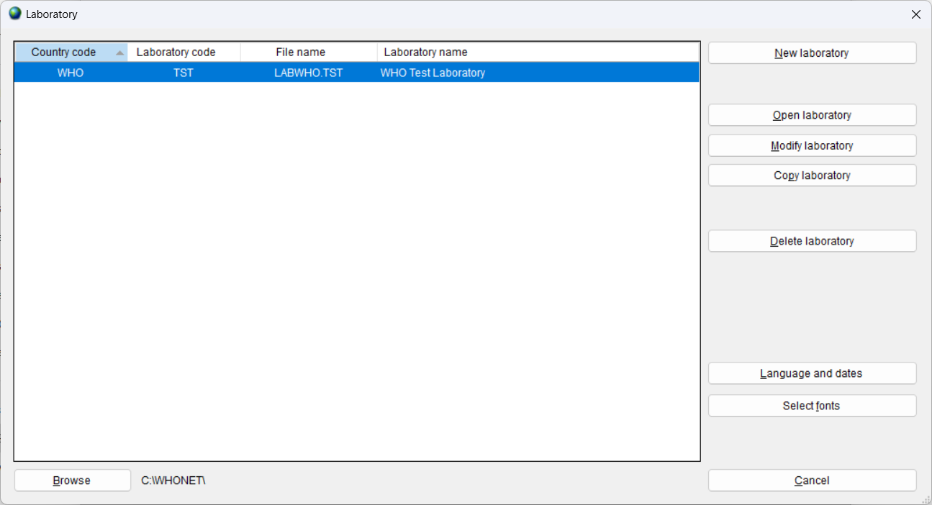
4
Open the laboratory
A

Slide 4
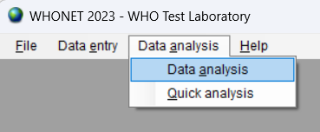
4
Select Data analysis
A
Data analysis = Interactive data analysis
- You choose the analysis parameters
Quick analysis = Pre-defined data analyses
- WHONET standard reports
- User-defined reports

Slide 5
Data analysis – required parameters
4
A

Slide 6
Click on “Analysis type”
4
A

Slide 7
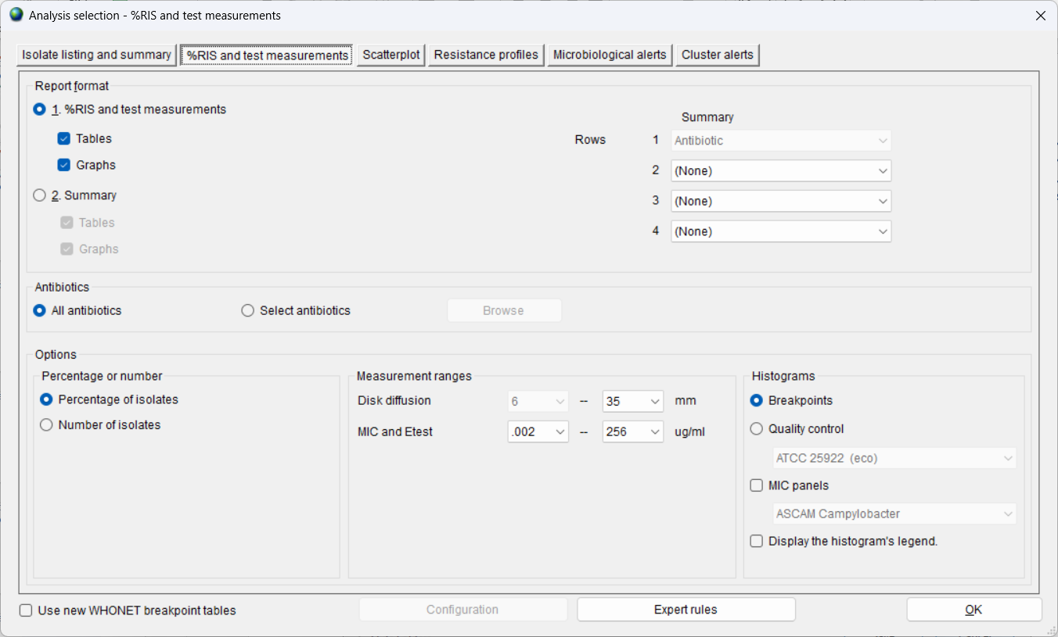
4
Select the Analysis type
Isolate listing and summary
%RIS and test measurements
Scatterplot
Resistance profiles
Microbiology alerts
Cluster alerts
A

Slide 8
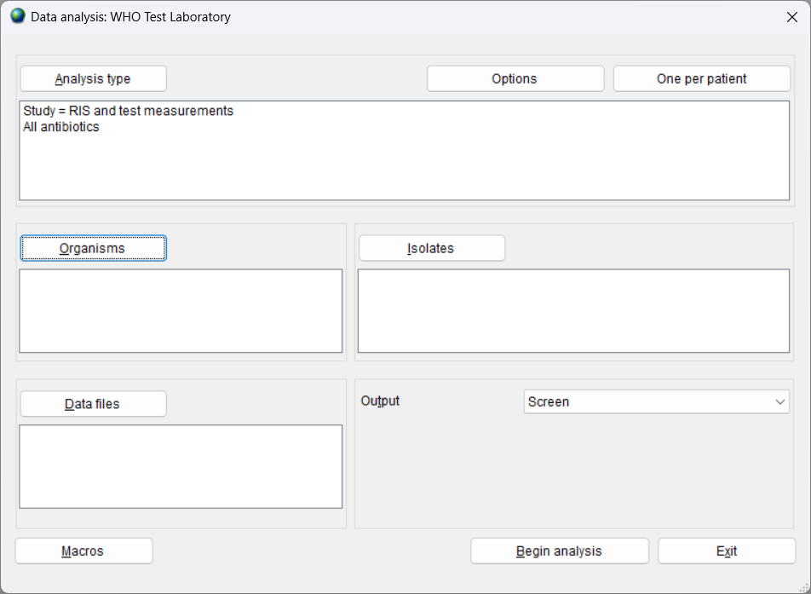
Click on “Organisms”
4
A

Slide 9
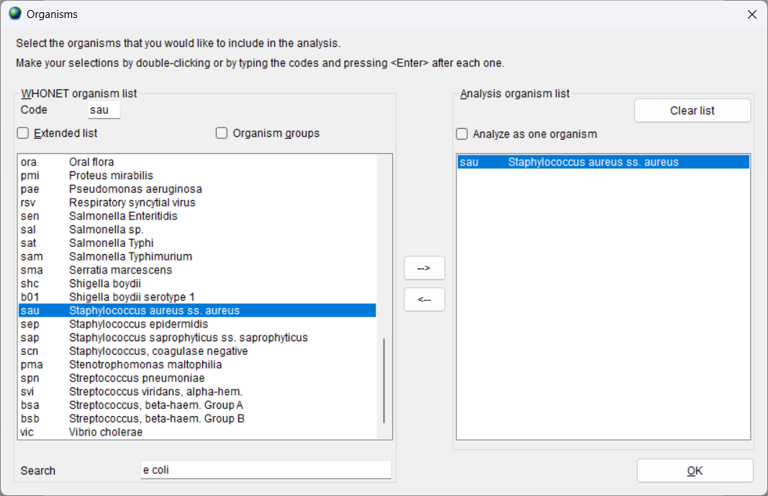
Selecting the organisms
4
A
Your options appear on the left, and your selections appear on the right.
If you know the code, enter the code, and hit Enter.
You can click on the organism on the left and click on the Right Arrow.
You can double-click on the organism on the left.

Slide 10
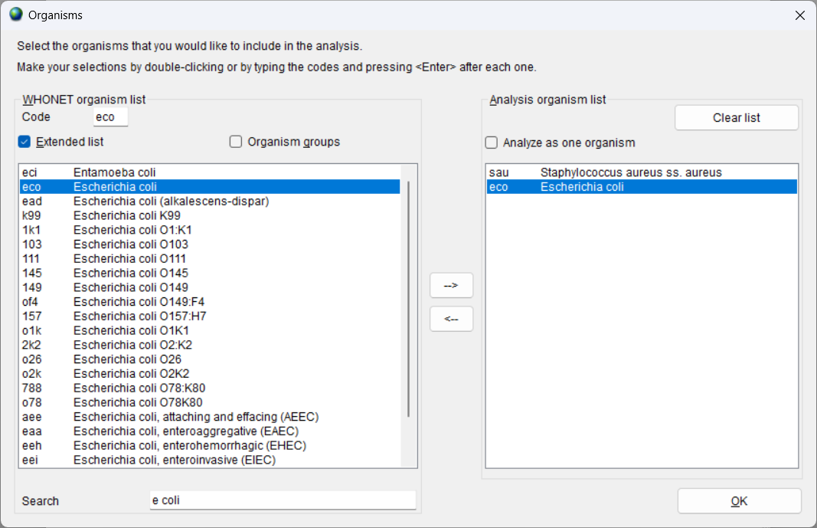
Searching for an organism
4
You can also search for the organism
A

Slide 11
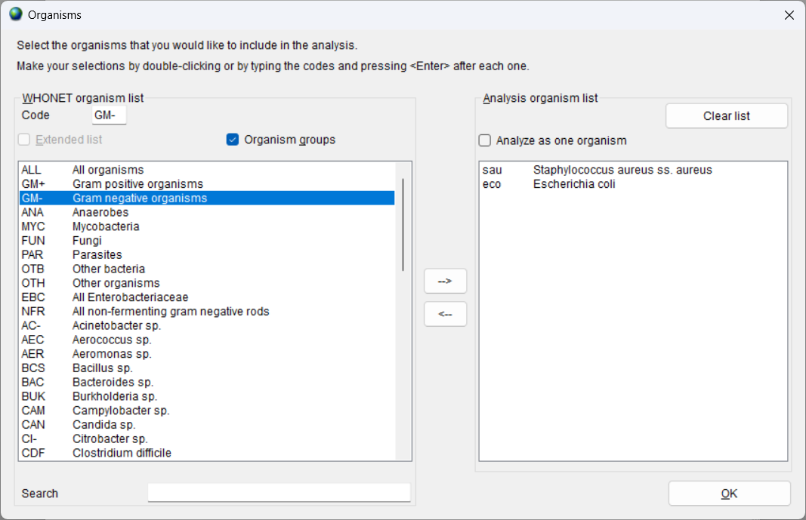
Select a group of organisms
4
A

Slide 12
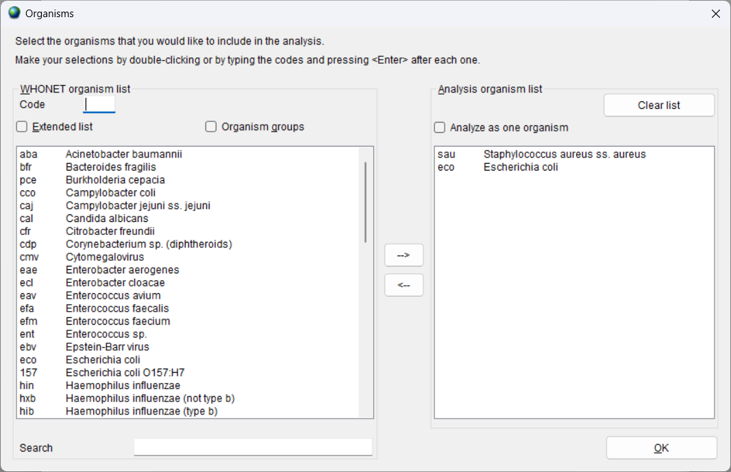
Analyze as one organism
4
A

Slide 13
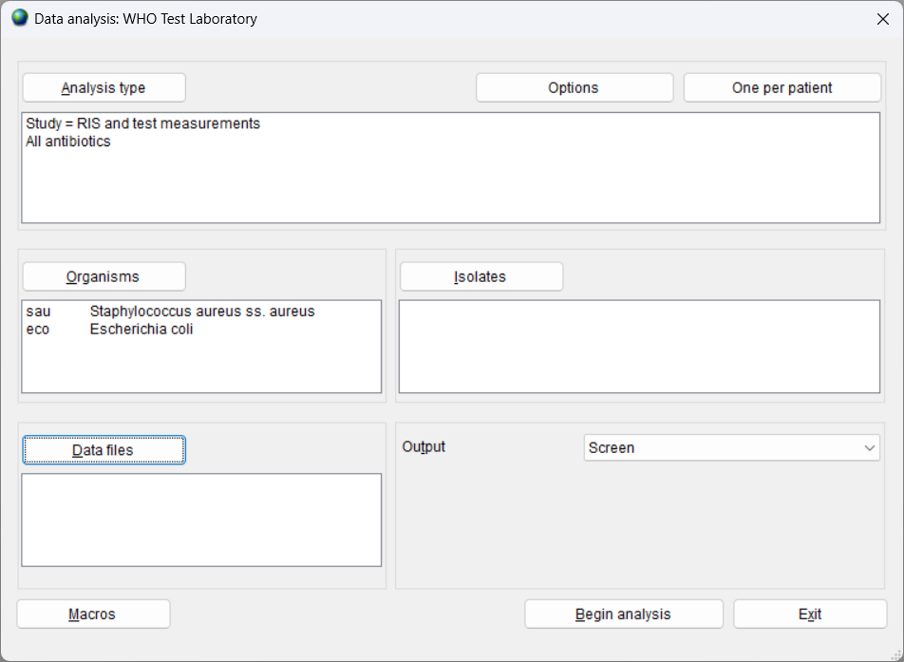
Click on “Data files”
4
A

Slide 14
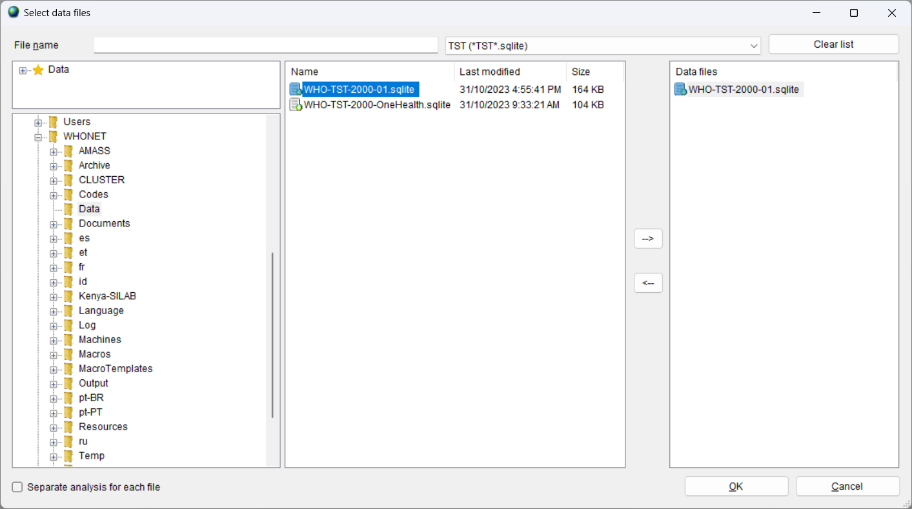
Select the data files
4
Your options appear on the left, and your selections appear on the right.
You can select a file using the Arrow buttons or you can double-click.
You can choose one file or many files.
The default file location is C:\WHONET\Data, but you can select other locations.
A

Slide 15
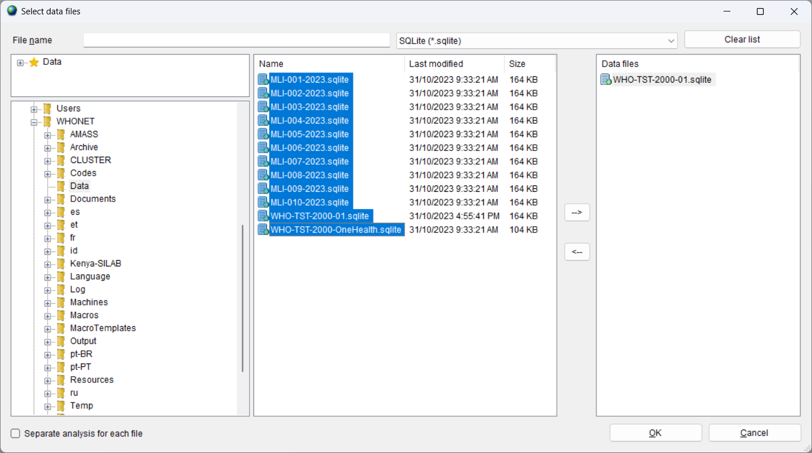
Select the data files
4
You can change the file filter to see more files.
You can choose files from a single laboratory or from many laboratories.
A

Slide 16
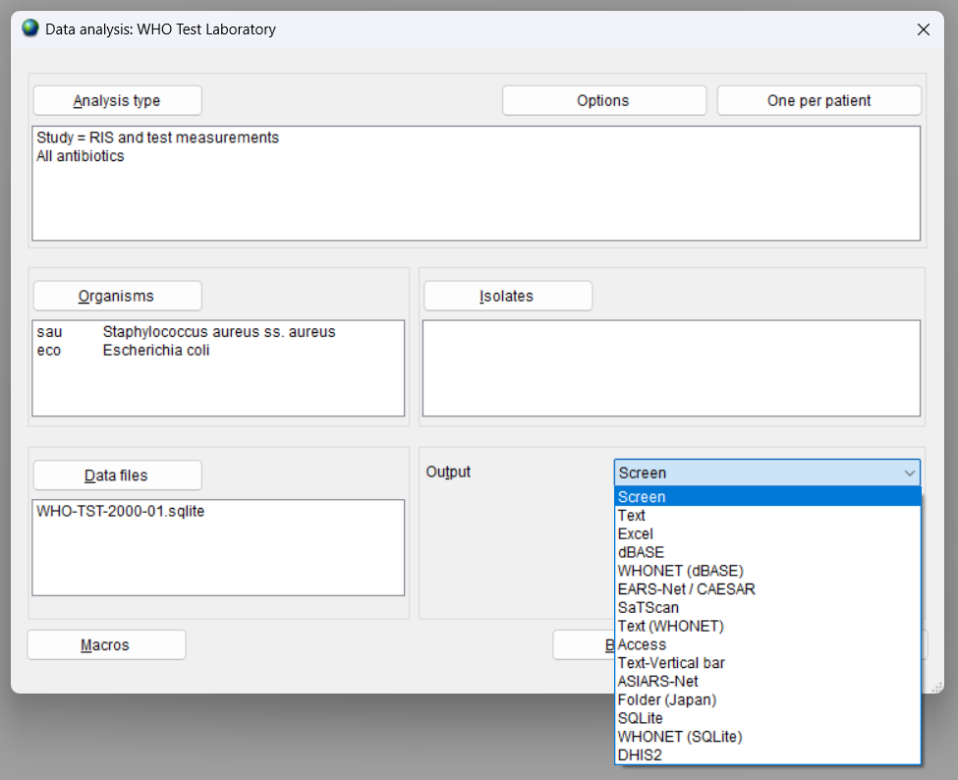
Select the output destination
4
A

Slide 17
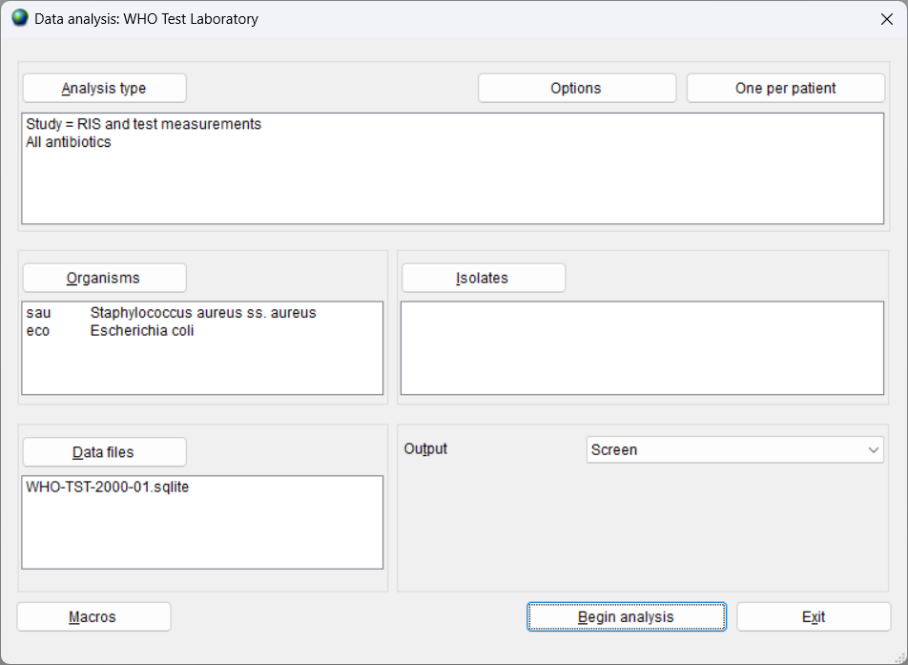
4
You have selected all of the required parameters
A

Slide 18
4
Module 4. Data analysis - Introduction
A
Selecting the required analysis parameters
B
Running the analysis
C
Selecting the optional analysis parameters
D
Macros

Slide 19
Analysis output – Begin analysis
4
A

Slide 20
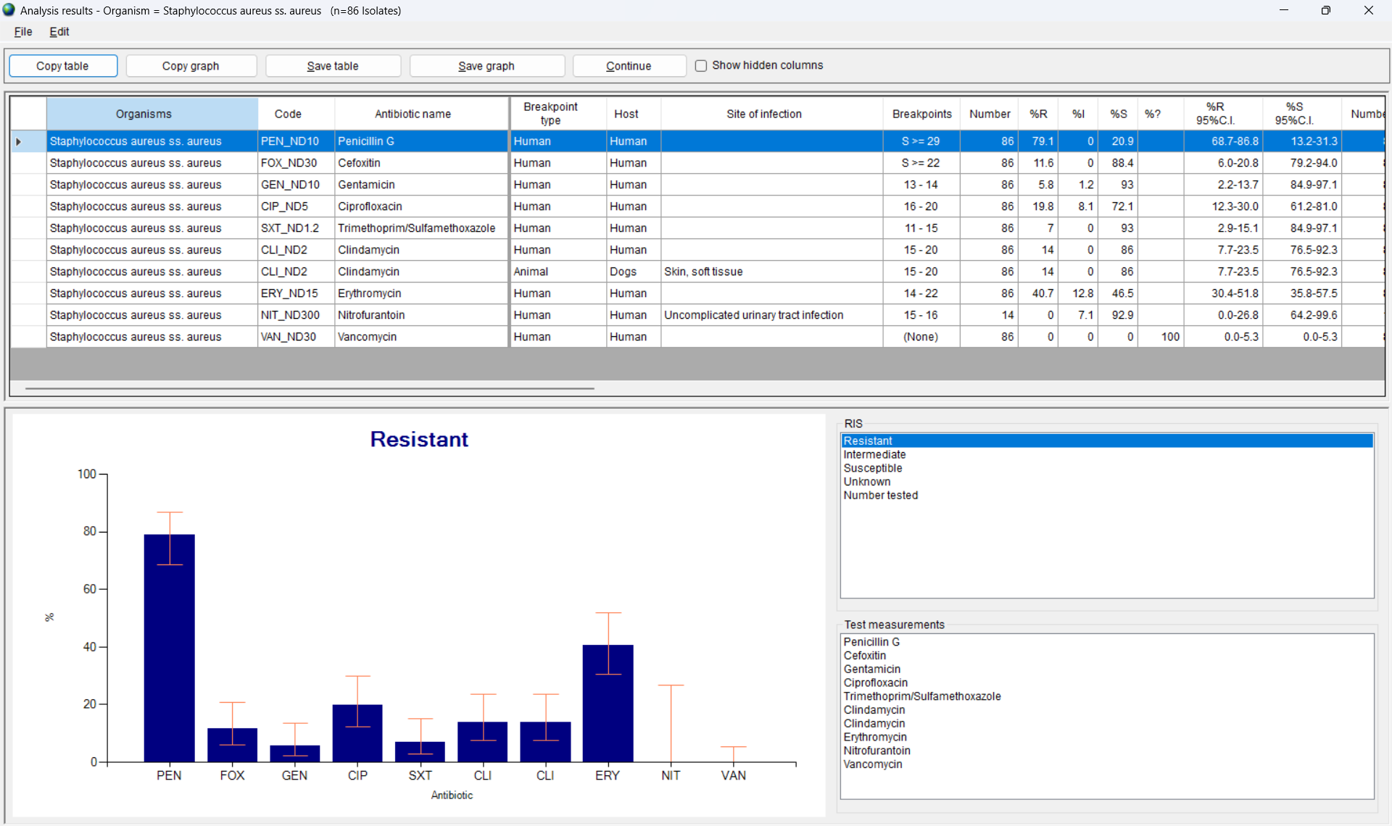
4
Analysis output
A

Slide 21
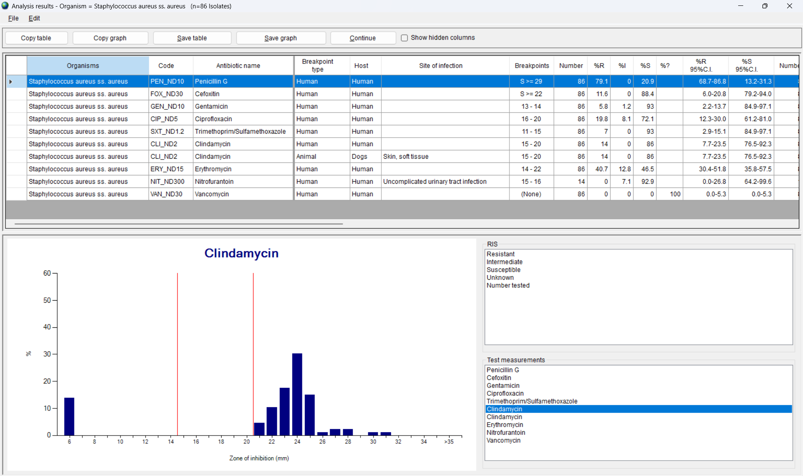
4
Select a different graph
A

Slide 22
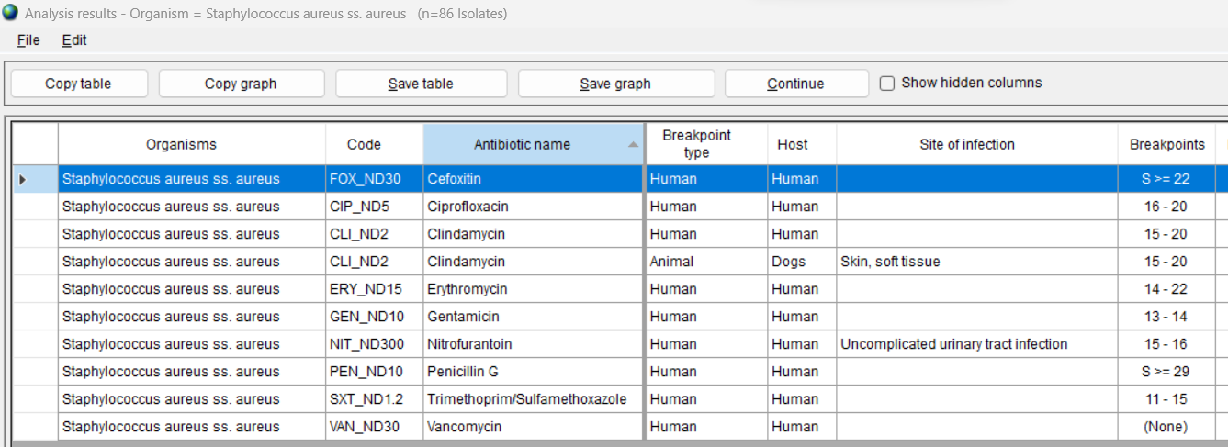
4
Sort the table
A
Click on a column heading to sort the table.

Slide 23
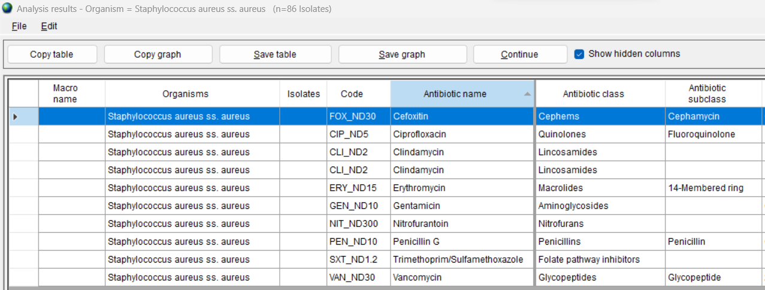
4
Show hidden columns
A

Slide 24
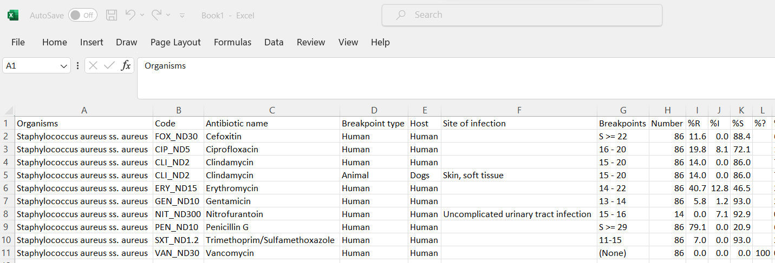
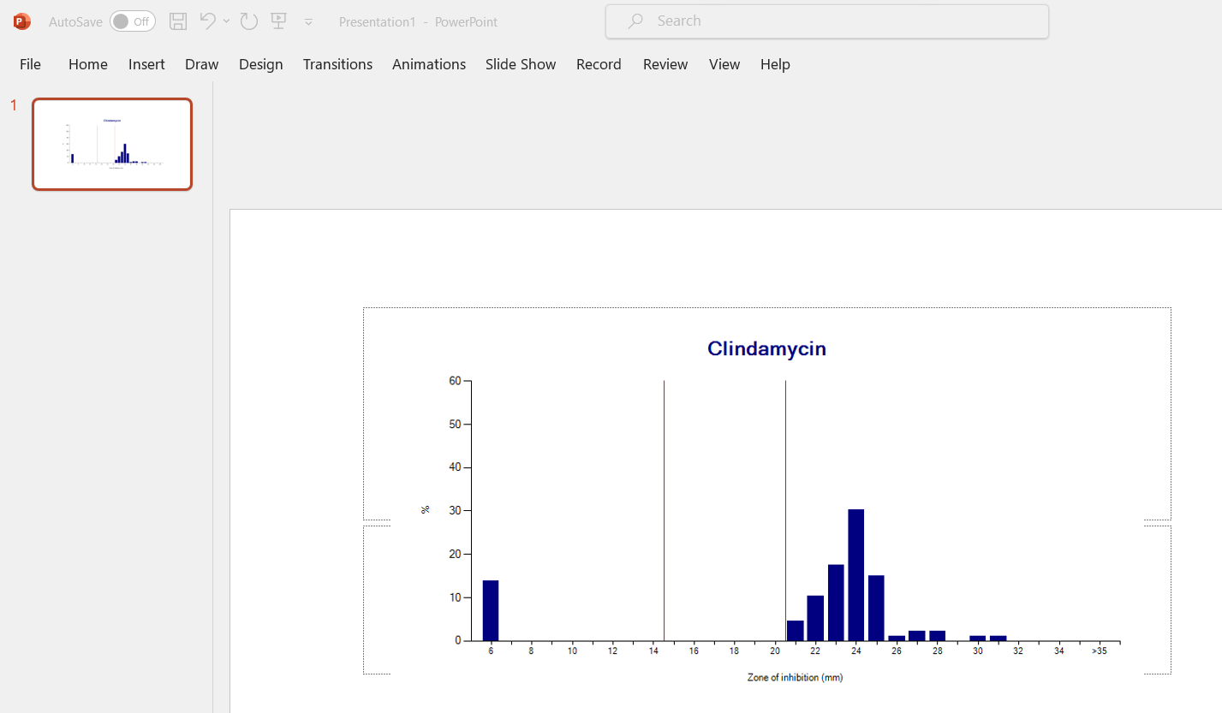
4
Copy table and copy graph
A
You can use “Copy table” and “Copy graph” to copy the results to Excel, Word, or PowerPoint.
Microsoft Excel
Microsoft PowerPoint

Slide 25
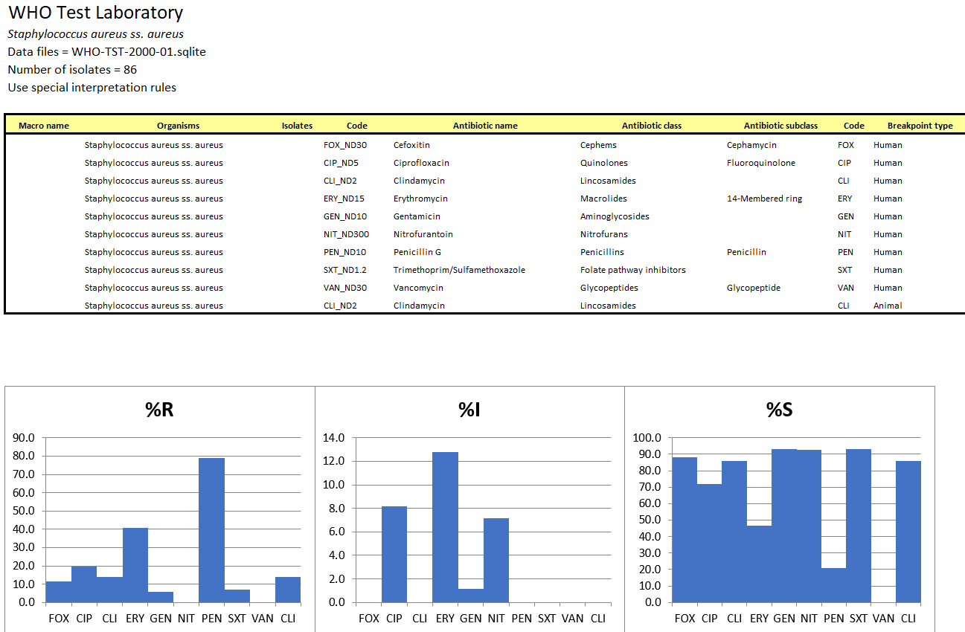
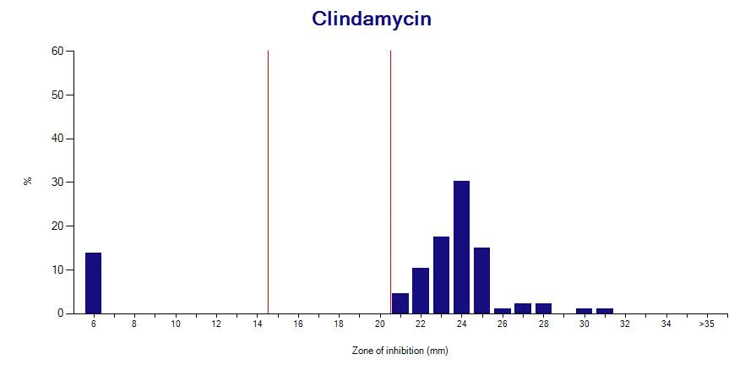
4
Save table and save graph
A
You can use “Save table” and “Save graph” to save the results to a file.
Microsoft Excel
JPEG File

Slide 26
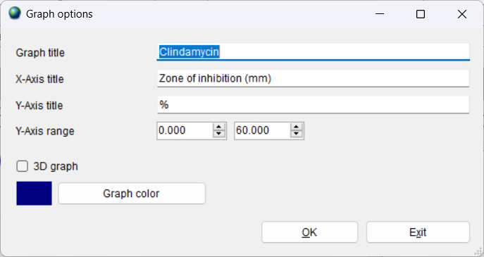
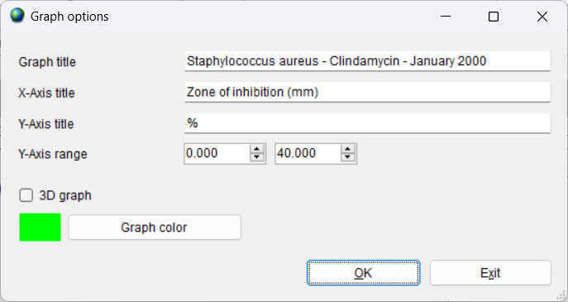
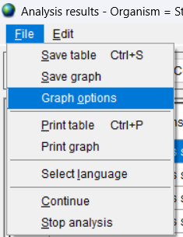
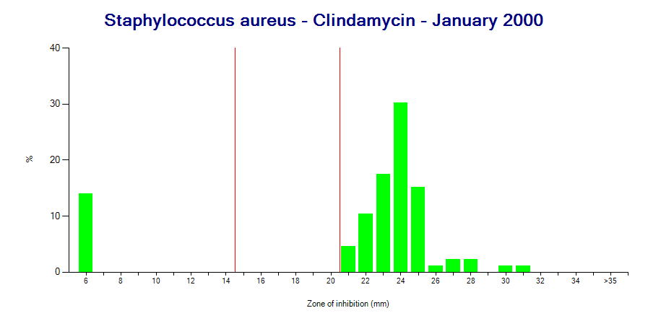
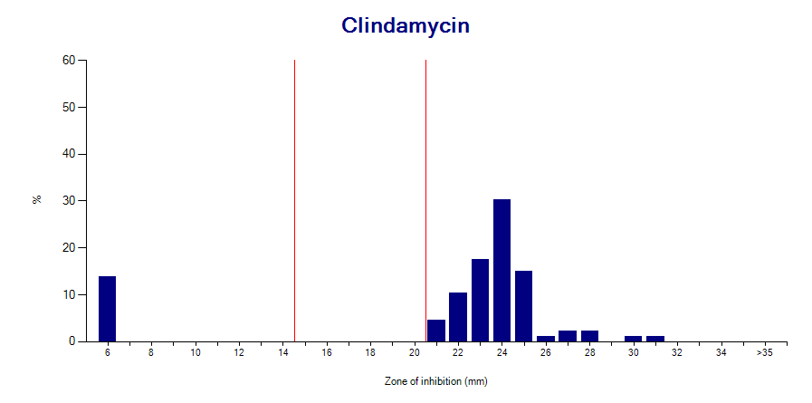
4
Graph options
A
WHONET offers the ability to make some modifications to the graph.
Click on “File”, “Graph options” or you can right-click on the graph.

Slide 27
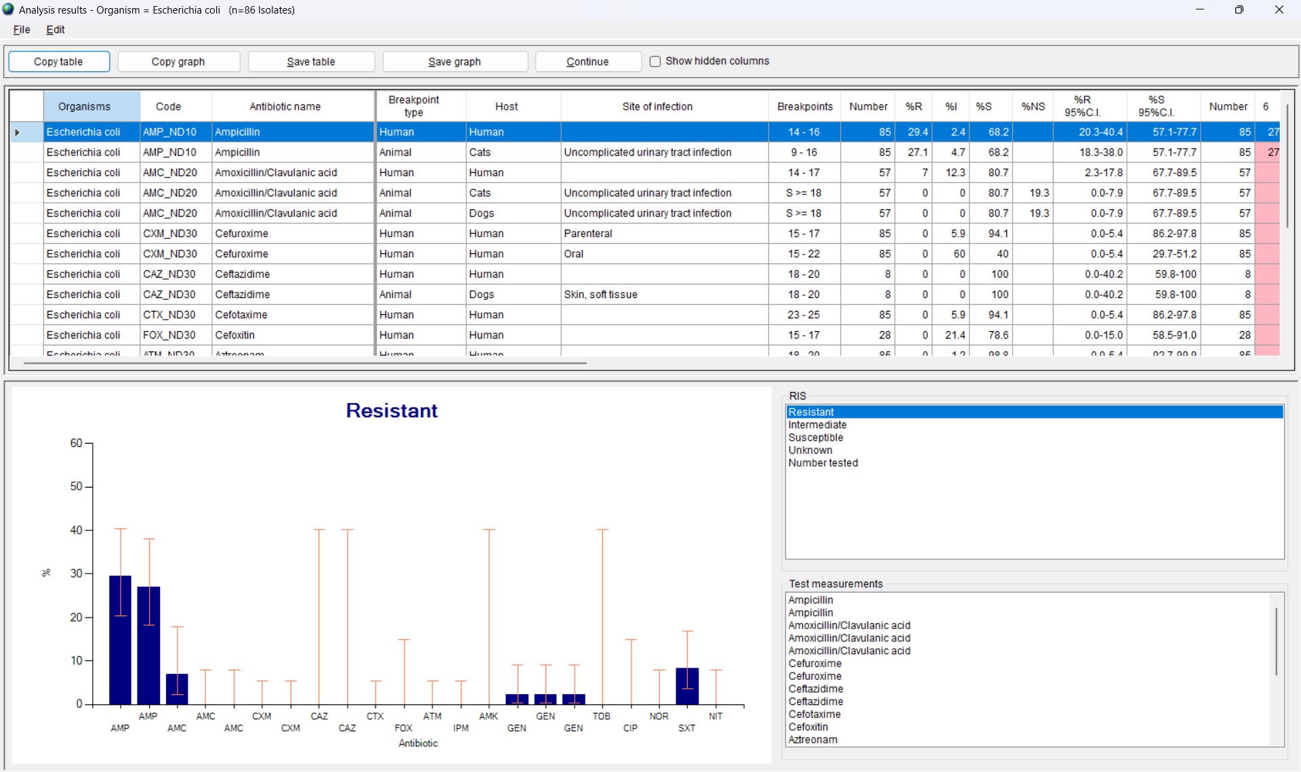
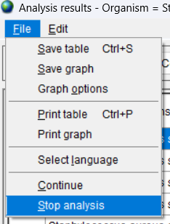
4
Click on Continue
A
When you finish reviewing the analysis results, click on “Continue” with the next organism – Escherichia coli.
If you want to end the analysis immediately, you can also click on “File”, “Stop analysis”.

Slide 28
4
Module 4. Data analysis - Introduction
A
Selecting the required analysis parameters
B
Running the analysis
C
Selecting the optional analysis parameters
D
Macros

Slide 29
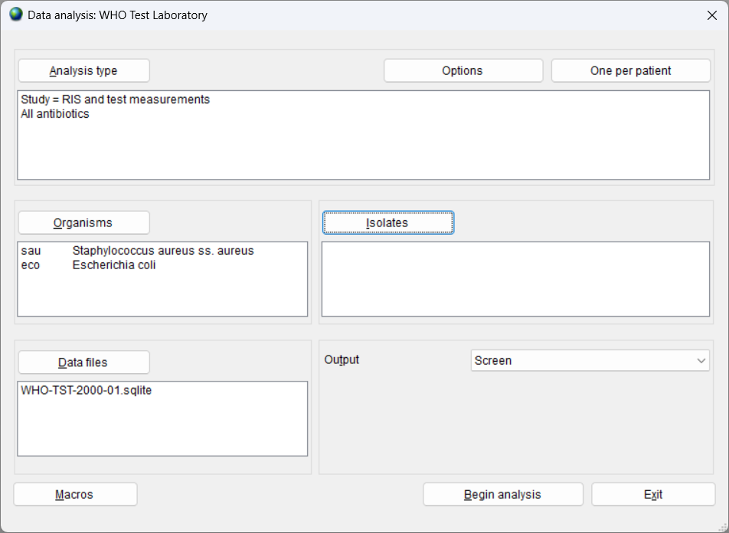
Data analysis – Optional parameters
4
A

Slide 30
Defining isolate filters
4
A

Slide 31
Defining isolate filters
4
A
WHONET allows you to define criteria for selection of specific patients, locations, specimen types, or test results.
Examples
Identification number = 12345
Sex = Female
Age group = 65+
Animal species = Chicken
Location type = Outpatient
Location type = Veterinary clinic or veterinary hospital
Specimen date = February 1, 2020 – February 15, 2020
Specimen type = Blood
Imipenem disk = Resistant

Slide 32
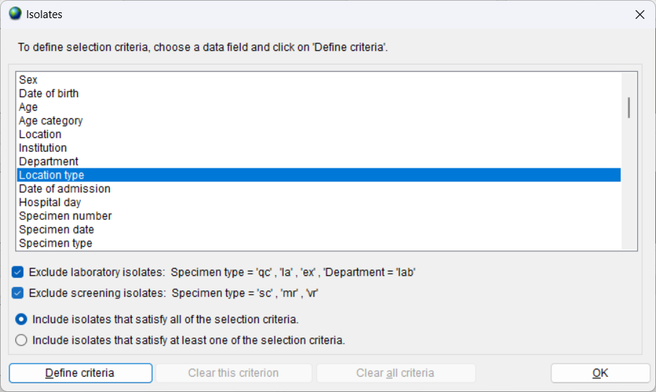
Isolate filters
4
A
Choose the data field for the filter, and click on “Define criteria”.

Slide 33
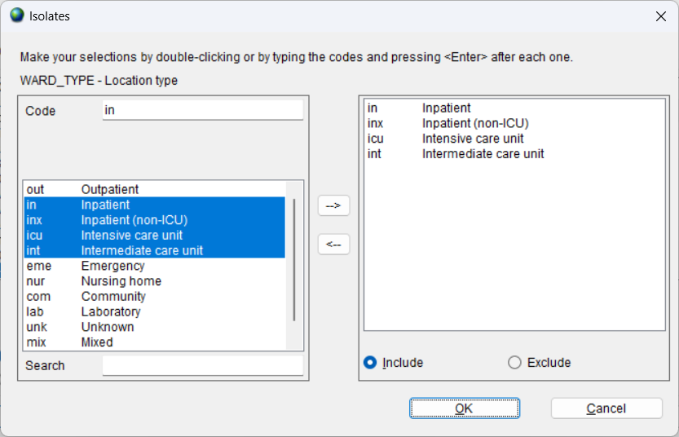
Isolate filters
4
A
Example: Location type = Inpatient (in, inx, icu, int)

Slide 34
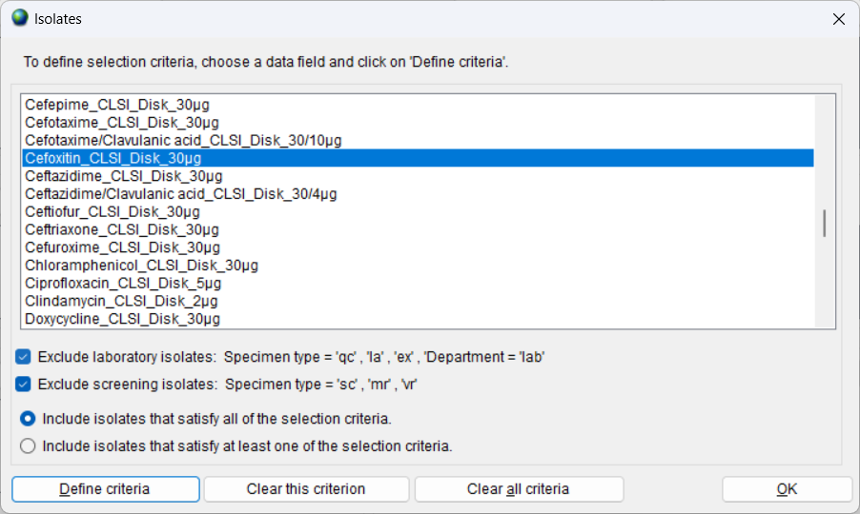
Isolate filters
4
A
Example: Cefoxitin Disk = Resistant

Slide 35
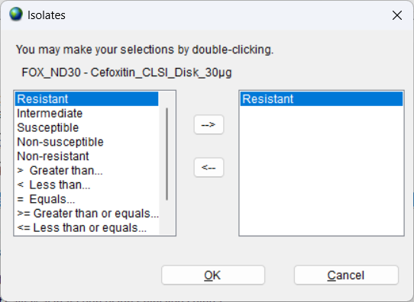
Isolate filters
4
A
Example: Cefoxitin Disk = Resistant

Slide 36
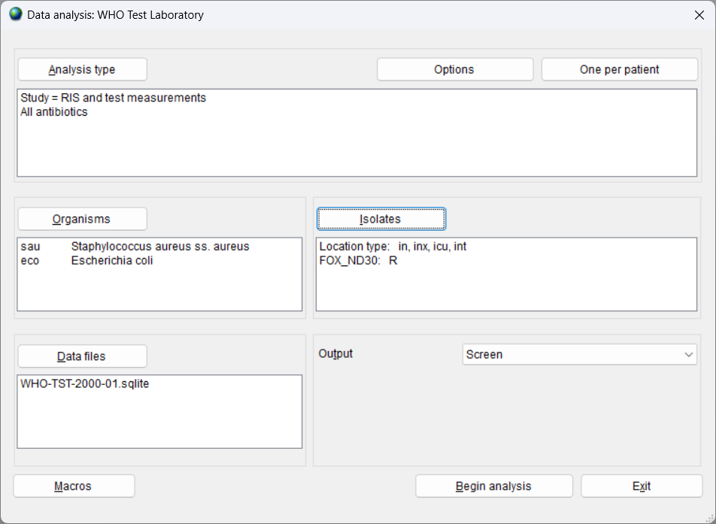
Analysis parameters – including filters
4
A

Slide 37
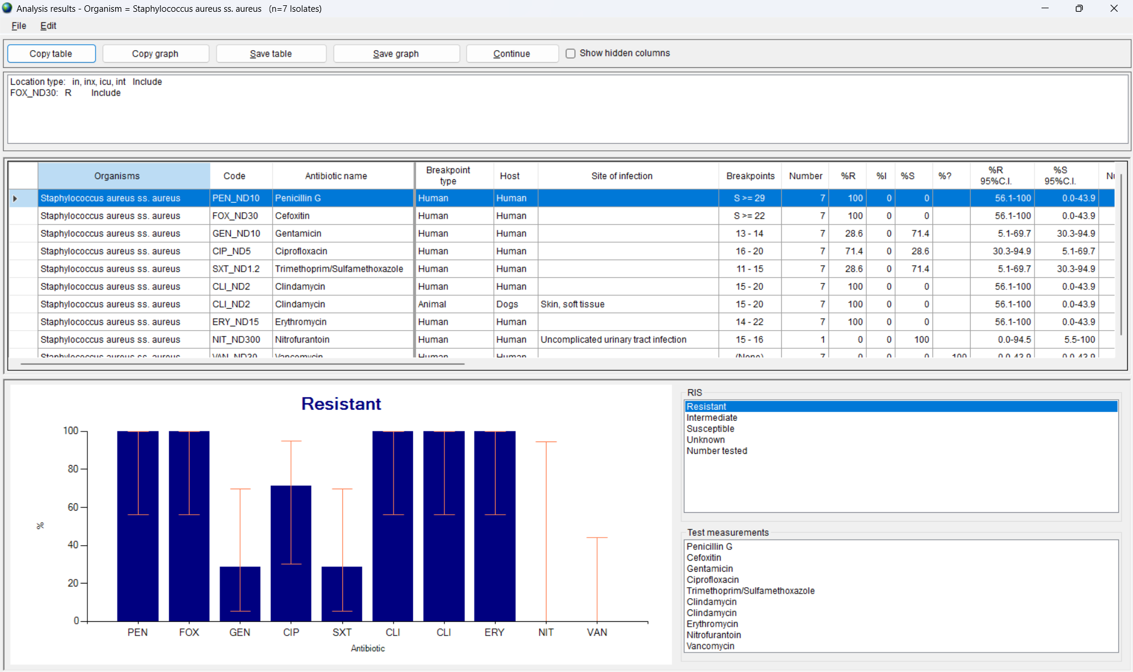
Analysis output – With filters
3
A

Slide 38
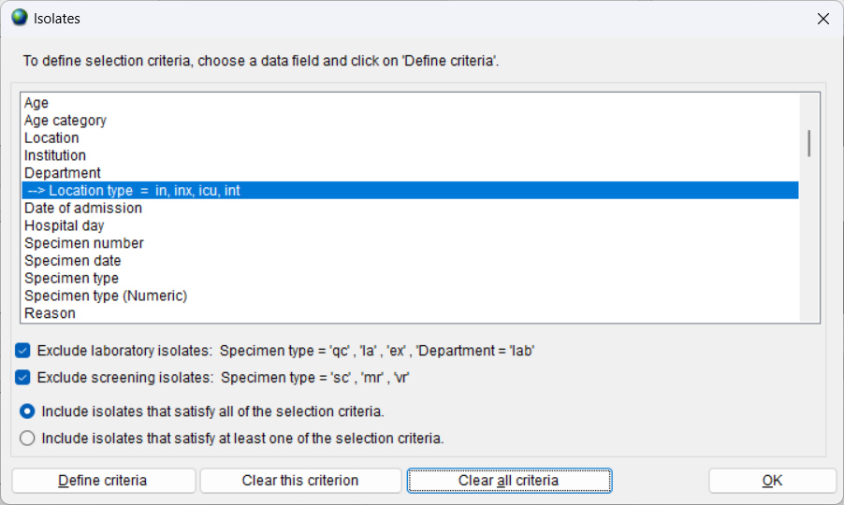
Remove isolate filters
4
A
Choose the data field for the filter, and click on “Define criteria”.

Slide 39
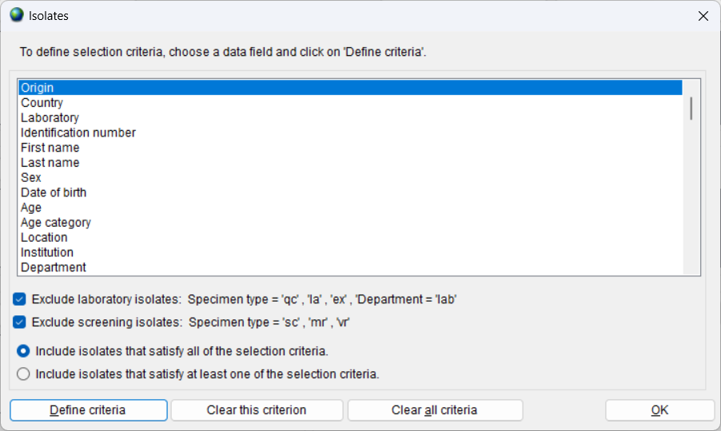
4
Automatic exclusions
A
By default, WHONET excludes laboratory samples (such as quality control) and screening samples (such as MRSA screening samples) because they do not come from diseased patients.
You can turn off these exclusions if you want to include all samples.
This can be valuable for laboratories which use the code ‘lab’ for diagnostic samples from patients visiting the laboratory.

Slide 40
4
Multiple criteria
A
If you define multiple criteria, by default, WHONET will select samples that meet all of the criteria.
Example: “Female” AND “Urine” AND “Outpatient”
But you can change this so that WHONET selects samples that meet at least one of the criteria.
Example: “Imipenem-Disk=Resistant” OR “Imipenem-MIC= Resistant” OR “Meropenem Disk=Resistant” OR “Meropenem-MIC=Resistant”

Slide 41
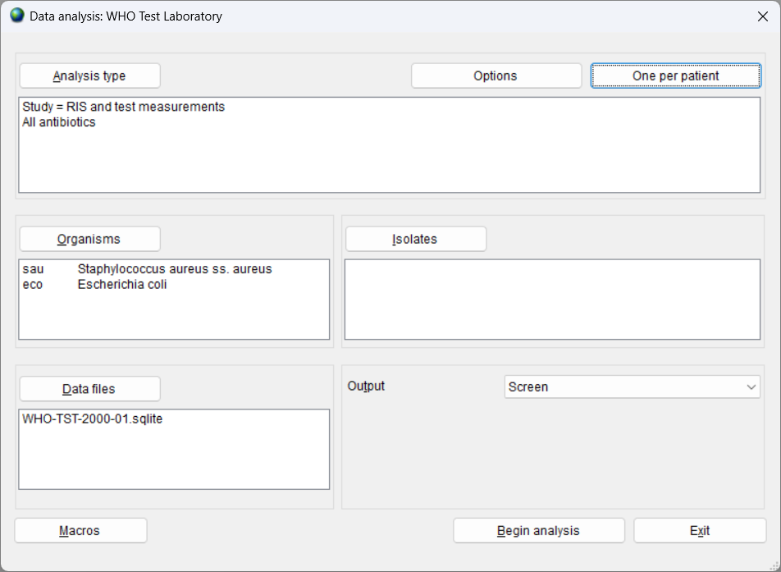
One per patient
4
A

Slide 42
4
Repeated isolation of the same species
A
It is common for human patients to have repeated isolation of the same microbial species on different days in different specimen types and in different patient care areas, especially in the hospital setting.
This can also happen in diseased animals, but this is less common.
It would also be rare to have repeated samples from healthy animals, food products, or environmental samples.

Slide 43
4
Resistance characteristics of the repeated isolations
A
The resistance characteristics of the repeated isolations may be identical, similar, or very different
Identical: This suggests that there are repeated isolations of the same microbial clone.
Similar:
This could imply that there are repeated isolations of the same clone, but with small issues of test reproducibility
It could also imply that the clones are genetically related but with some mutations which distinguish them.
Very different: This would generally imply that the patient is infected with genetically distinct strains, though multiple mutations could also be an explanation.

Slide 44
4
Management of repeat results
A
WHONET offers three approaches for the handling of repeated isolations
By isolate: all isolates are considered equally in the analysis
By patient: each patient is counted once in the analysis
WHONET offers several ways to do this.
By “episode” of infection: WHONET uses two approaches for defining an episode
Time interval between consecutive isolates
Resistance characteristics of the isolates

Slide 45
Option – By isolate
4
A
Advantages
Valuable for documenting the workload of the laboratory.
Valuable for identification of priority strains and rare resistance,
Disadvantages
Usually overestimates %Resistance since patients with many repeat isolates often have greater resistance.
Unreliable for cluster detection.

Slide 46
Option – By patient
4
A
Advantages
Decreases bias in estimates of resistance rates
Important for development of treatment guidelines
Important for monitoring of trends
Disadvantages
Needs a reliable patient identifier, which is not always available.
Interesting strains might be excluded from the analysis.
First isolate only. Recommended when the analysis does not address antimicrobial resistance. Example: How many isolates of Escherichia coli are in the database?
First isolate with antibiotic results. Recommended for studies of antimicrobial resistance. Example: What is the percentage of patients with Escherichia coli resistant to ampicillin.

Slide 47
4
Recommendation for preparation of annual statistics
A
A table with the annual aggregate statistics on antimicrobial resistance is often referred to as an antibiogram.
A common use of antibiograms is to guide recommendations for empiric therapy for patients who do not yet have any microbiological results.
To support recommendations for empiric therapy, the recommendation from the CLSI M39 document and others is to prepare the antibiogram using the first isolate per patient per species.
Advantages of this approach
Clinically meaningful for decisions for empiric therapy
Simplest recommendation to data analysts for preparing standardized antibiograms.

Slide 48
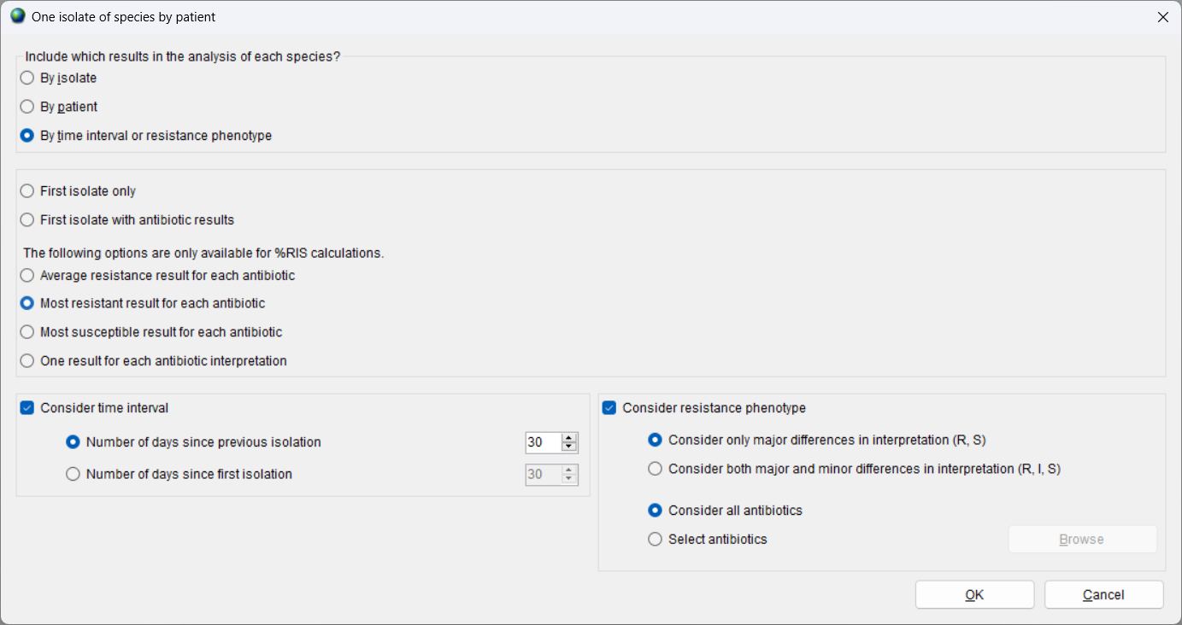
4
Option – By time period and resistance phenotype (By “episode”)
A
Advantages
Valuable to infection control teams in monitoring episodes of infections
Can be used to track strains with different resistance characteristics.
Disadvantages
No standard definitions, which would need to be modified by organism.
For purposes of empiric therapy recommendations, usually overestimates resistance rates.
Example: How many episodes of bacteremia were there in hospitalized patients last year?

Slide 49
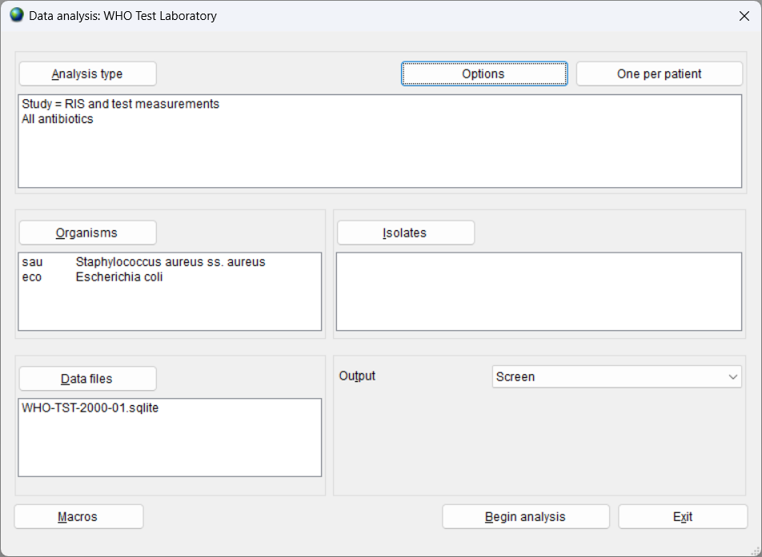
Other analysis options
4
A

Slide 50
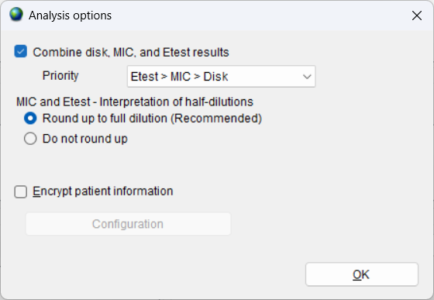
Combine disk, MIC, and Etest results
4
A
This feature is useful in two situations
If an isolate is tested by more than one method, then WHONET combine the results into a single interpretation. The user can indicate the priority of each method.
If some laboratories test isolates by disk diffusion and other laboratories test by MIC, then the national aggregate statistics can include results from both methods in a single summary statistic.

Slide 51
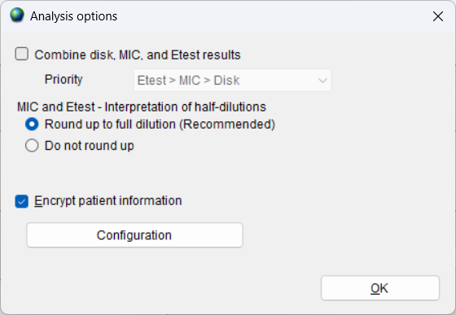
Encrypt patient information
4
A
This feature is useful for analyses which include isolate listings.
Isolate listing and summary
Resistance profile – Isolate listing
Isolate alerts
Cluster alerts – Isolate listing
With this feature you can delete or encrypt confidential information such as patient names, identification numbers, and dates of birth.
The options will be described further in a different module under the feature “Combine, export, or encrypt data files”.

Slide 52
4
Module 4. Data analysis - Introduction
A
Selecting the required analysis parameters
B
Running the analysis
C
Selecting the optional analysis parameters
D
Macros

Slide 53
Introduction to macros
WHONET users often wish to repeat the same set of analyses on a regular basis
Daily, weekly, monthly, quarterly, yearly or ad hoc
Different audiences: Laboratory staff, infectious diseases, infection control, pharmacy, national authorities, funders
The purpose of macros is to permit you to repeat analyses that you have done previously
The macros will remember the analysis type, organisms, isolate filters, data files, and other analysis parameters that you have selected
You can repeat the analyses on the same data files or on new files from the same laboratory or from other laboratories.

Slide 54
Benefits of using macros
Macros and reports save time and promote consistency with repeated analyses. There is no need to remember all of the details about which organisms and other analysis options were selected.
One WHONET user can create macros and reports for many other WHONET users, which promotes standardization and collaborative discussions of results both within a single institution and across many institutions.
WHONET macros can be scheduled to run automatically, for example, daily, weekly, or monthly.

Slide 55
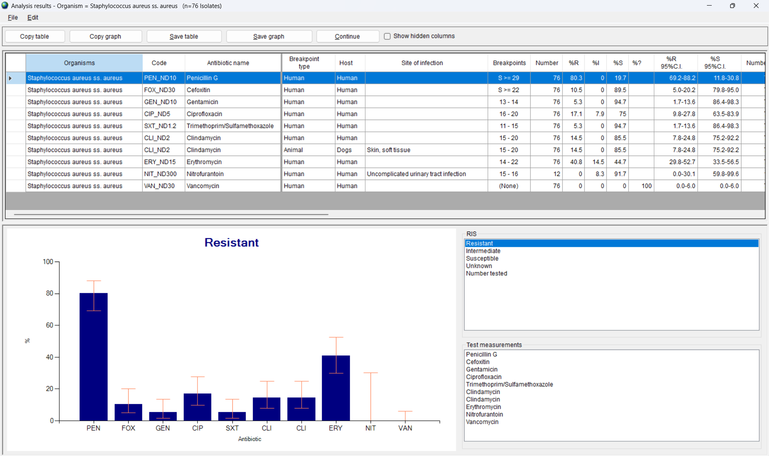
Running a WHONET analysis
Go to WHONET data analysis and choose the analysis parameters that you are interested in.
Example: Using the WHO Test Laboratory, choose “%RIS”, “Staphylococcus aureus” and “Escherichia coli”, and the “WHO-TST-2000-01.sqlite” data file. Also choose “First isolate with antibiotic results”.
You can then “Begin analysis” to ensure that the results agree with your expectations.

Slide 56
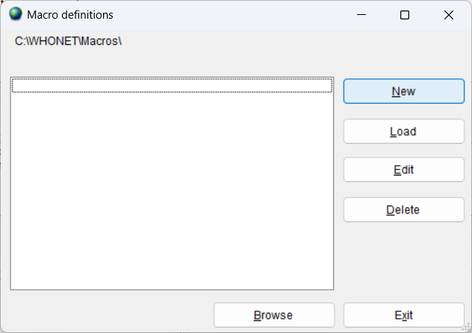
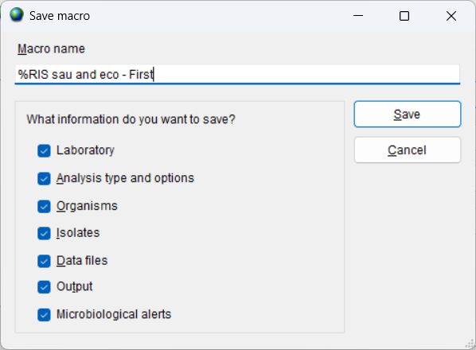
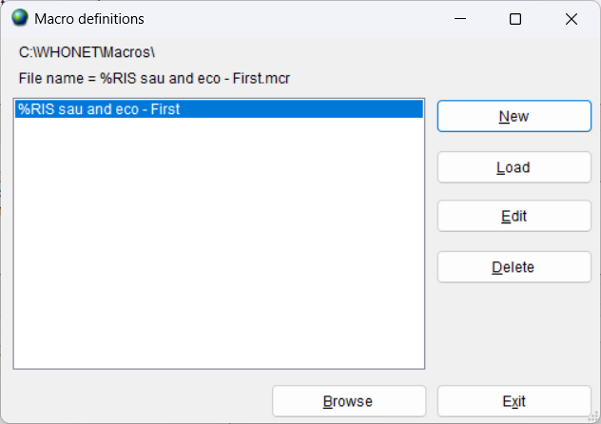
Creating a WHONET macro
Click on “Macros” to get the below screen, then click on “New”.
Enter a name for the new macro, and then click “Save”
Example: %RIS sau and eco – First
Enter a name for the new macro file, and then click “Save”
Example: %RIS sau and eco – First.mcr
By default, your macro files will be saved in C:\WHONET\Macros

Slide 57
Using a WHONET macro
Go to WHONET Data analysis and click “Macros”.
You will see a list of all of the macros. Choose the macro that you are interested in. Click on “Load”.
This will load into the analysis screen the parameters that you selected earlier.
You can either click on “Begin analysis” immediately. Or you can make changes, such as different data files or organisms or isolate filters.

Slide 58
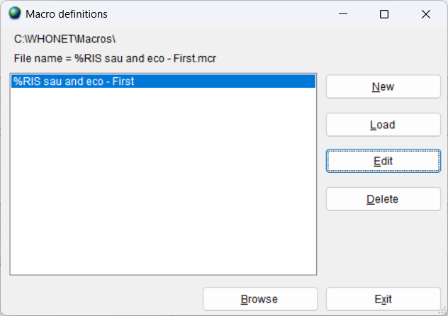
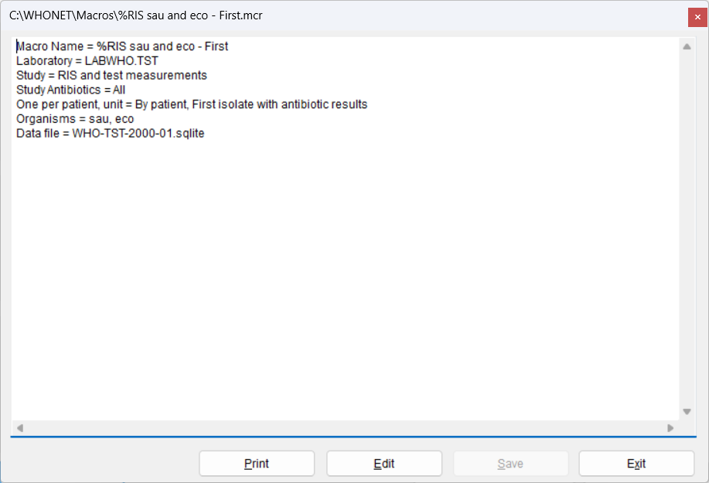
Editing a macro using WHONET
Go to WHONET Data analysis and click “Macros”.
You will see a list of all of the macros. Choose the macro that you are interested in. Click on “Edit”.
You will then see the parameters that defined for the macro. If you want to make changes, click on “Edit”. Then when you finish, click “Save” and “Exit”.
You can use Windows if you want to rename the macro file.

Slide 59
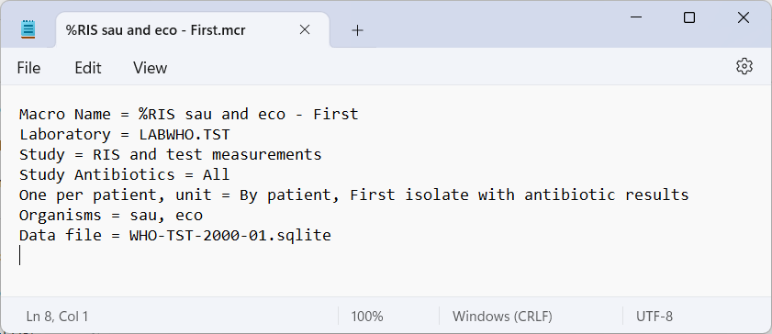
Editing a macro using NotePad
Macros are simple text files and can be edited with any text editor, such as NotePad.
By default, WHONET macros are saved in C:\WHONET\Macros.
Find the macro that you wish to edit. You can edit this file, or you can make a copy and edit the copy.
Windows File Explorer
NotePad

Slide 60
How to share or backup a macro
By default, WHONET files are stored in the location C:\WHONET\Macros.
From here, you can make backup copies or send copies to your colleagues by email.
Macros generally have no confidential information in them, so can be freely shared with collaborators
Rare exception: if you define a macro using patient names or other confidential information, then you should not share these.

Slide 61
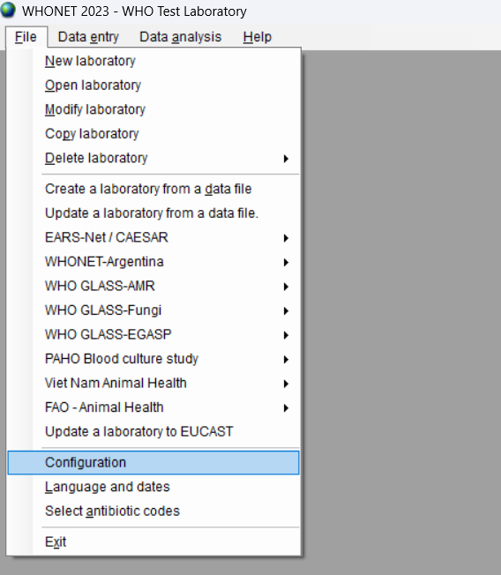
Default location for macros
By default, WHONET macros are saved in the folder C:\WHONET\Macros
You can change this location through the “Configuration” option on the main “File” menu.

Slide 62
Editing a macro using WHONET
Go to WHONET Data analysis and click “Macros”.
You will see a list of all of the macros. Choose the macro that you are interested in. Click on “Edit”.
You will then see the parameters that are defined for the macro. If you want to make changes, click on “Edit”. Then when you finish, click “Save” and “Exit”.
You can use Windows if you want to rename the macro file.

Slide 63
Editing a macro using NotePad
Macros are simple text files and can be edited with any text editor, such as NotePad.
By default, WHONET macros are saved in C:\WHONET\Macros.
Find the macro that you wish to edit. You can edit this file, or you can make a copy and edit the copy.
Windows File Explorer
NotePad

Slide 64
How to share or backup a macro
By default, macro and report files are stored in the location C:\WHONET\Macros.
From here, you can make backup copies or send copies to your colleagues by email.
Macros generally have no confidential information in them, so can be freely shared with collaborators
Rare exception: if you define a macro using patient names or other confidential information, then you should not share these.

Slide 65
Default location for macros and reports
By default, WHONET macros are saved in the folder C:\WHONET\Macros
You can change this location through the “Configuration” option on the main “File” menu.

Slide 66
Introduction to reports
Single WHONET macros can be bundled into multi-part WHONET reports.

Slide 67
4
Thank you for watching Module 4:
Up next. Module 5: Data analysis- Interactive analysis with WHONET, Part 1

